Slide 1








Introduction to
Juberiya Ajaz presents
Web-development
May 2022

Slide 2




Slide 3





Who am I?
Ex- Mentor at Creatica and La hacks.
20+ mentees
Volunteered for more than 5 organizations.
Open- Source contributor at GSSoC22.
Ece sophomore from INDIA.

Slide 4

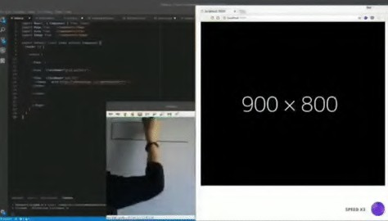


Slide 5




What is web development?
01
02
Introduction to front end development
03
What is HTML , CSS and JavaScript
04
Introduction to HTML
05
Introduction to CSS
06
Introduction to JavaScript
07
Resources

Slide 6

01 What is Web Development?

Slide 7


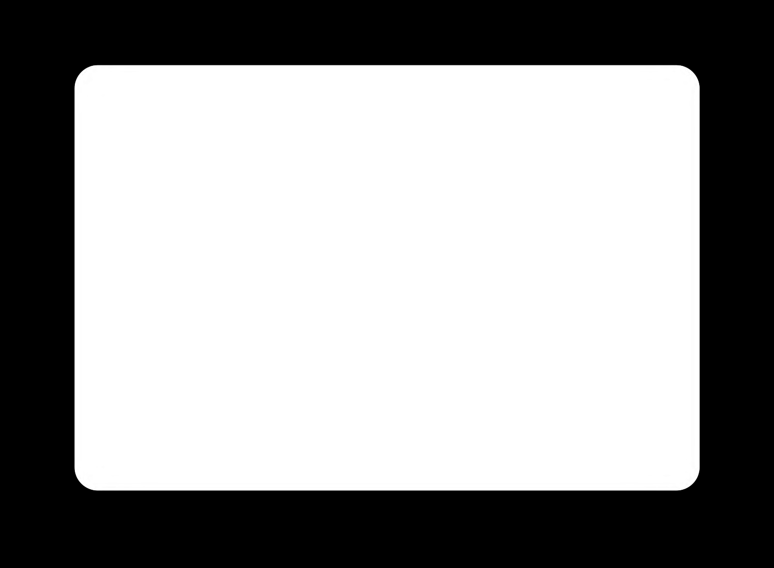
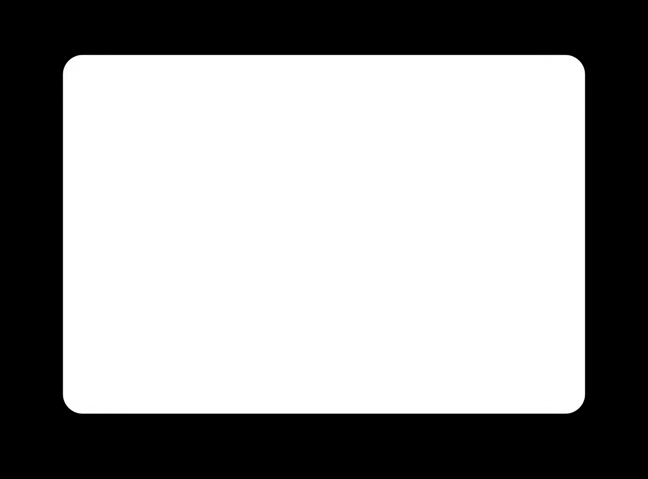
Front-end Development
Back-end Development
Front-end web development is the development of the graphical user interface of a website, through the use of HTML, CSS, and JavaScript, so that users can view and interact with that website.
Backend developers build code that allows a database and an application to communicate with one another. Backend developers take care and maintain the back-end of a website, including databases, servers, and apps, and they control what you don’t see.

Slide 8

02 Introduction to front end development

Slide 9





Front-end Development
In web programming, they're ways of telling your browsers what to do.
When you open a web page,
your browser fetches the HTML and
other programming languages involved and interprets it.HTML and CSS are actually not technically programming languages;
they're just page structure and style information.
HTML
CSS
JavaScript

Slide 10

03 What is HTML CSS and JavaScript?

Slide 11
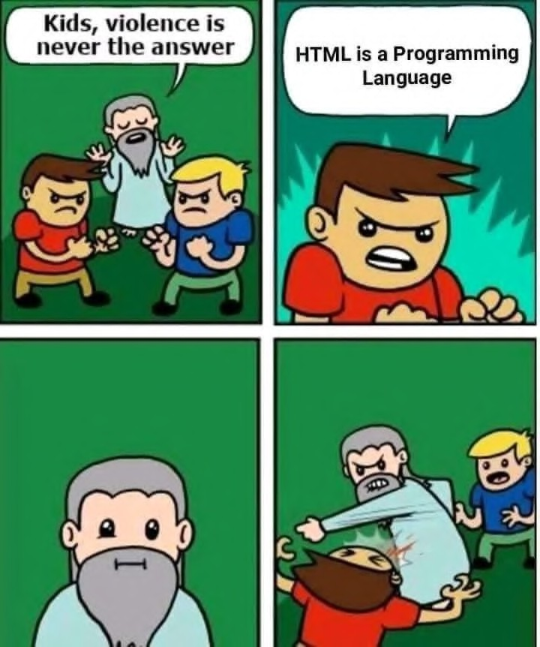
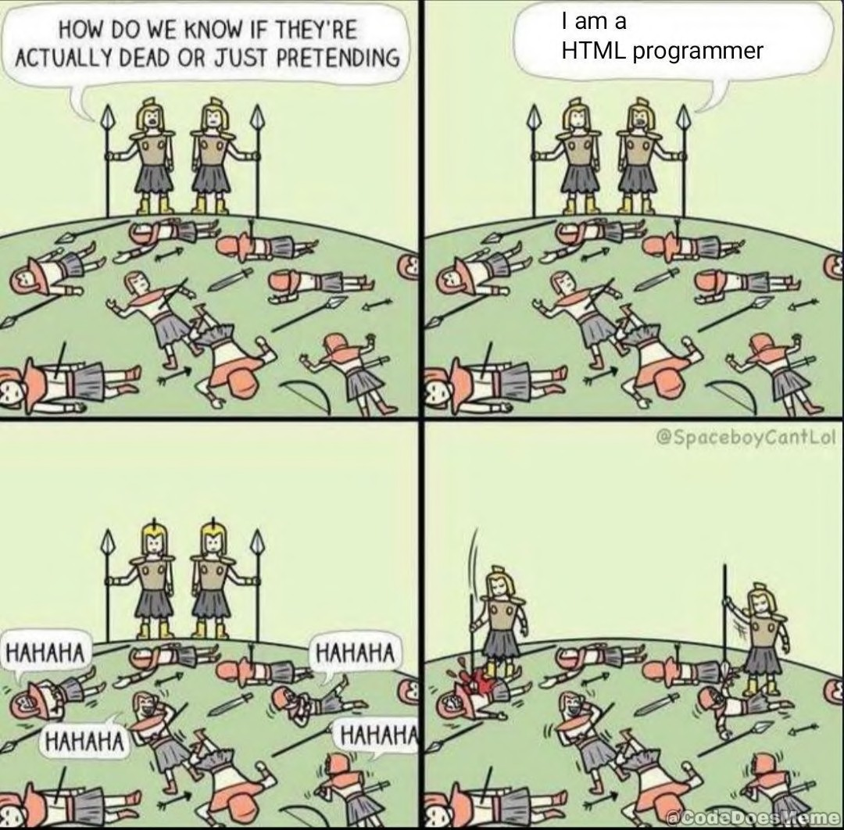

Slide 12

HTML
JAVASCRIPT
CSS
JavaScript is a logic-based programming language that can be used to modify website content and make it behave in different ways in response to a user's actions.
HTML provides the basic structure of sites, which is enhanced and modiied by other technologies like CSS and JavaScript.
CSS is used to control design ,presentation, formatting, and layout.

Slide 13





04 Introduction to HTML

Slide 14
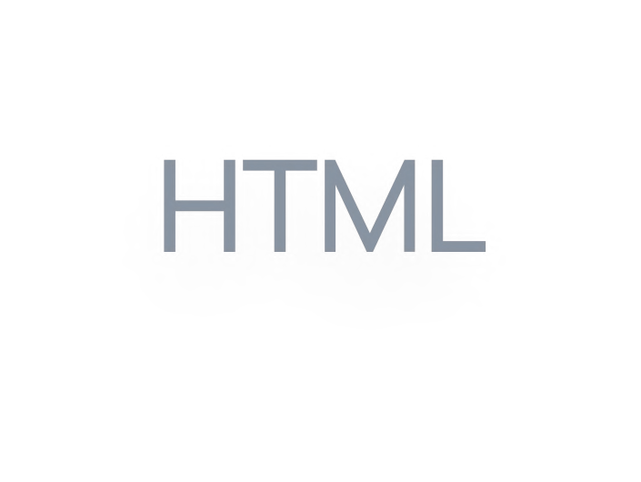

HTML is at the core of every web page, regardless of the complexity of a site or the number of technologies involved.
Every web page is made up HTML tags denoting each type of content on the page.
Each type of content on the page is "wrapped" in, HTML tags. For example, the words you’re reading right now are part of a paragraph. If I were coding this web page from scratch I would have started this paragraph with an opening paragraph tag:
<p>. The "tag" part is denoted by open brackets, and the letter "p" tells the computer that we’re opening a paragraph.
Once a tag has been opened, all of the content that follows is assumed to be part of that tag until we "close" the tag. When the paragraph ends, we'd put a closing paragraph tag: </p>.
HTML stands for HyperText Markup Language. "Markup language" means that, rather than using a programming language to perform functions, HTML uses tags to identify different types of content and the purposes they each serve to the webpage.
HTML tags, also known as "elements." These tags have pretty intuitive names: Header tags, paragraph tags, image tags, and so on.

Slide 15

Tags | Function
<p> Paragraph Tag </p> | This tag formats any text between the opening <p> tag and the closing </p> tag as a standard paragraph or main body text.
<h2> Heading Tag </h2> | Using this tag will format any text between the opening <h2> tag and the closing </h2> tag as a Heading 2 (a type of subheading.)
<b> Bold Tag </b> <i> Italic Tag </i> <u> Underline Tag</u> <em> Emphasis tag </em> | This tag will format any text between the opening tag and the closing tag as bold, italic, underline and emphasis respectively.
<ul > unordered list </ul> <ol> ordered list <ol> | Creates unordered and ordered
<br> | Creates single line break
<div> | Creates division in body
<a> | Anchor tag for a link

Slide 16

This is a Heading
<html>
<title>Page Title</title>
<body>
<h1>This is a Heading</h1>
<p>This is a <b> bold </b> and <i> italic </i>paragraph.</p>
<div> This a division with a <a href="url">link text</a></div>
<ul> Unordered list
<li>Coffee</li>
<li>Tea</li>
</ul>
<ol> Ordered list
<li>Coffee</li>
<li>Tea</li>
</ol>
</body>
</html>
This is a bold and italic paragraph. This a division with a link text
Unordered list
Coffee
Tea
Ordered list
Coffee
Tea

Slide 17



TD elements define table cells
<html>
<style>
table, td {
Emil
Tobias
Linus
border:1px solid black;
}</style><body>
<h2>TD elements deine table cells</h2>
To understand the example better, we have added borders to the table.
<table style="width:100%">
<tr><td>Emil</td>
<td>Tobias</td>
<td>Linus</td></tr>
</table>
<p>To undestand the example better, we have added borders to the table.</p>
</body>
</html>

Slide 18
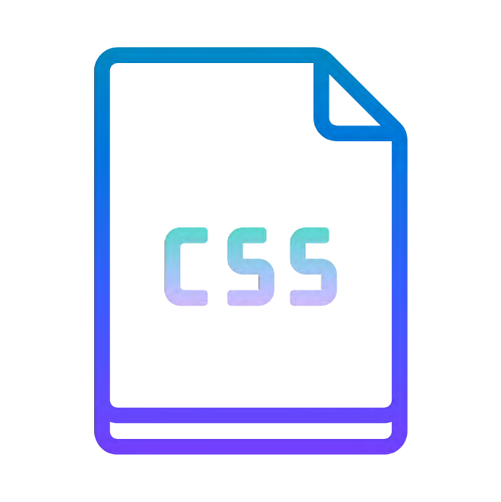
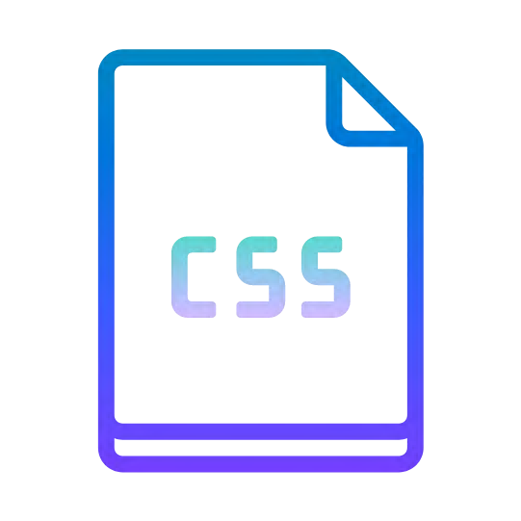
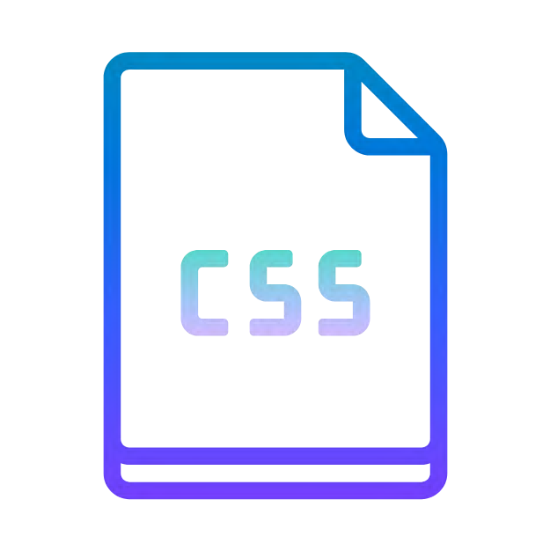
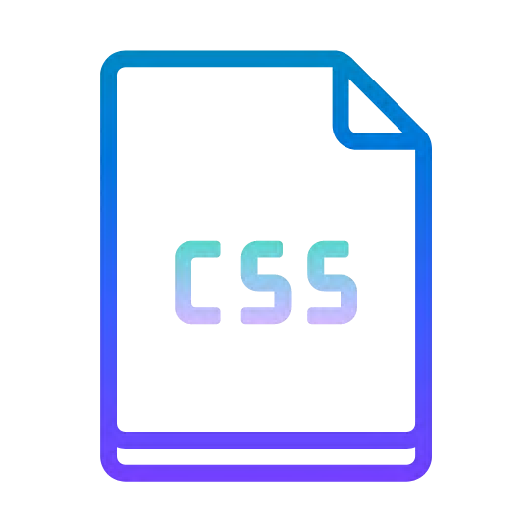
05 Introduction to CSS

Slide 19
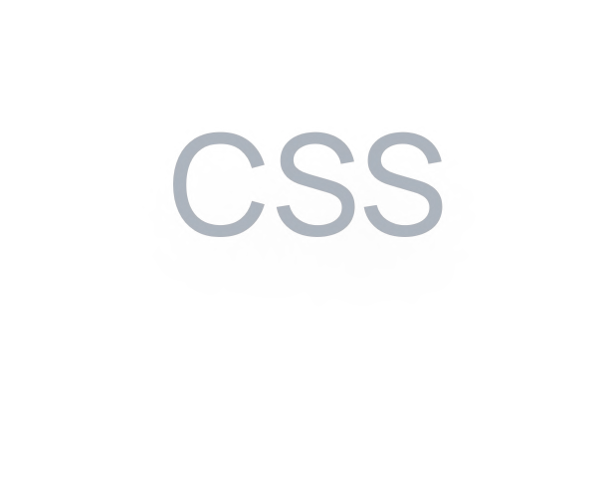
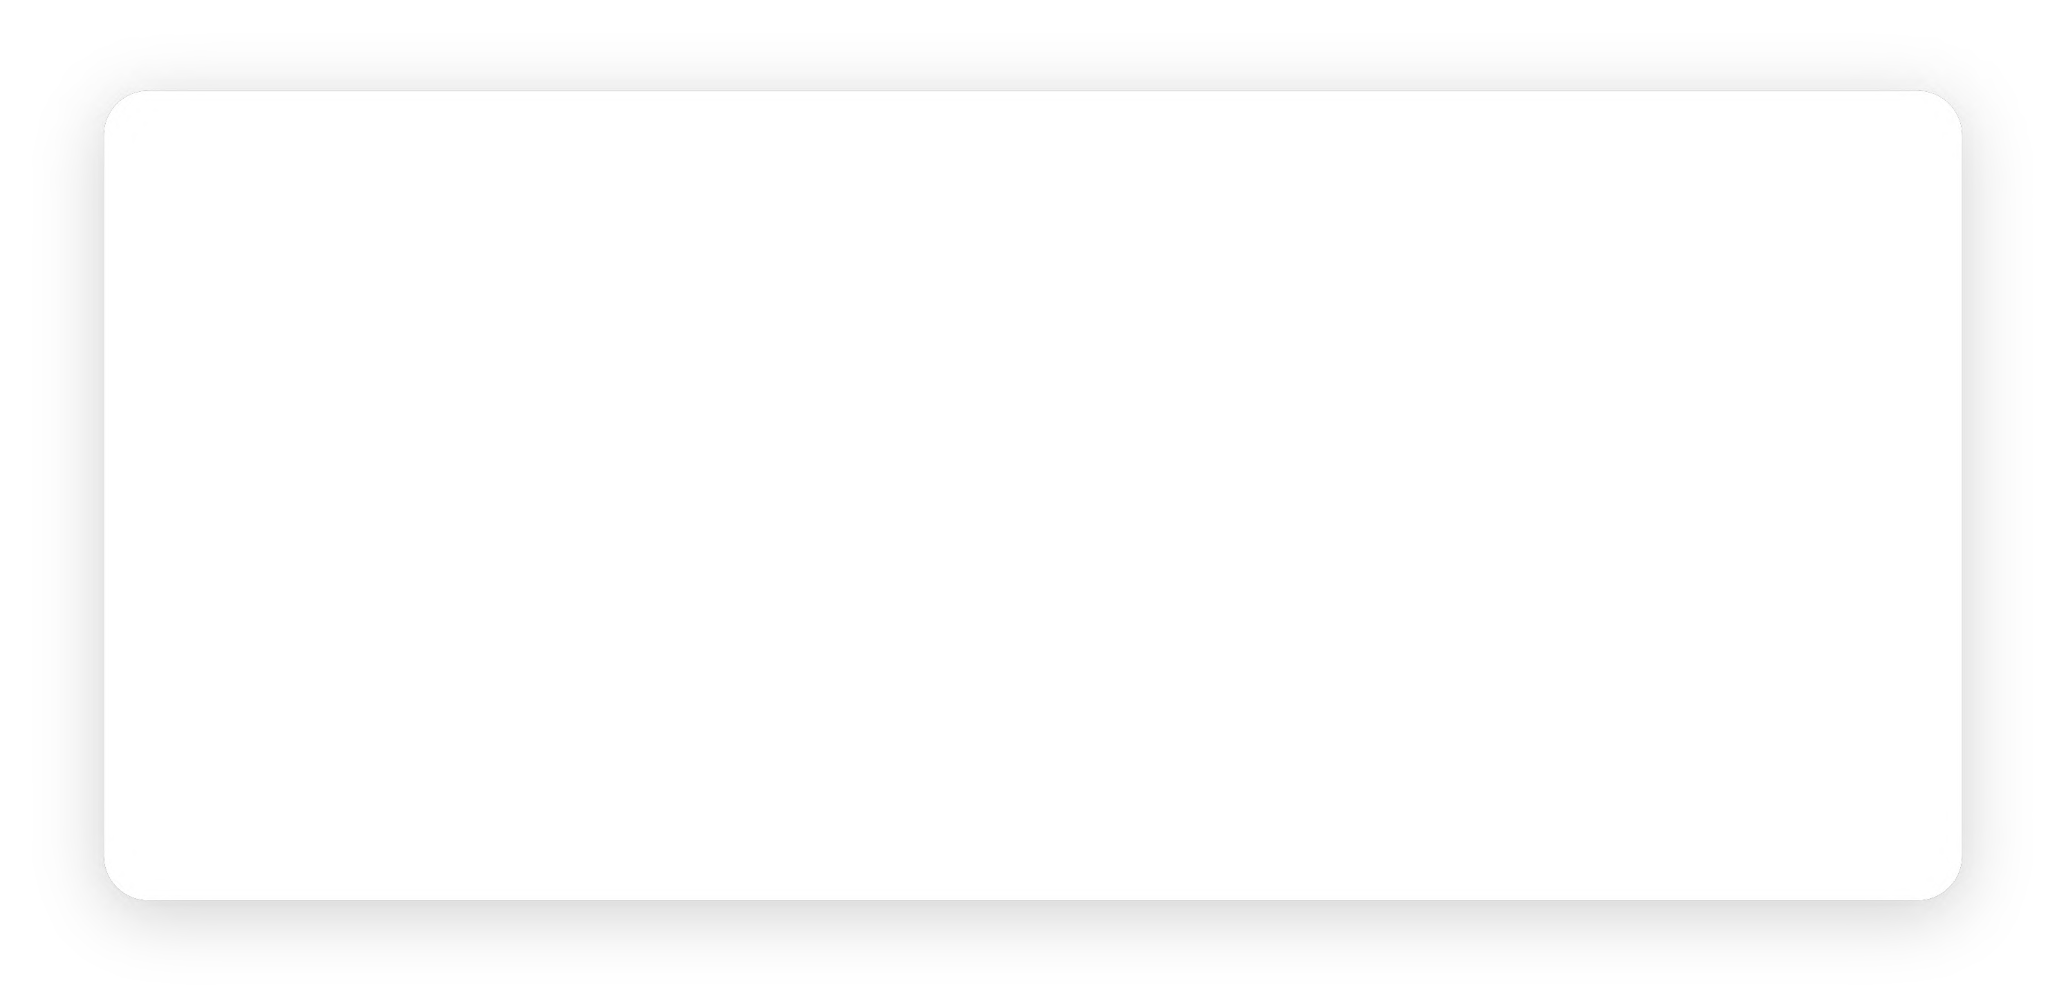
CSS stands for Cascading Style Sheets. It dictates how the HTML elements of a website should appear on the front-end of the page.
If HTML is the drywall, CSS is the paint.HTML provides the raw tools needed to structure content on a website. CSS, on the other hand, helps to style this content so it appears to the user the way it was intended to be seen.
CSS saves a lot of work. It can control the layout of multiple web pages all at once.
HTML was NEVER intended to contain tags for formatting a web page!HTML was created to describe the content of a web page, like:<h1>This is a heading</h1
When tags like <font>, and color attributes were added to the HTML 3.2 speciication, it started a nightmare for web developers. The development of large websites, where fonts and color information were added to every single page, became a long and expensive process.
To solve this problem, the World Wide Web Consortium (W3C) created CSS.

Slide 20


Selector in CSS

Slide 21

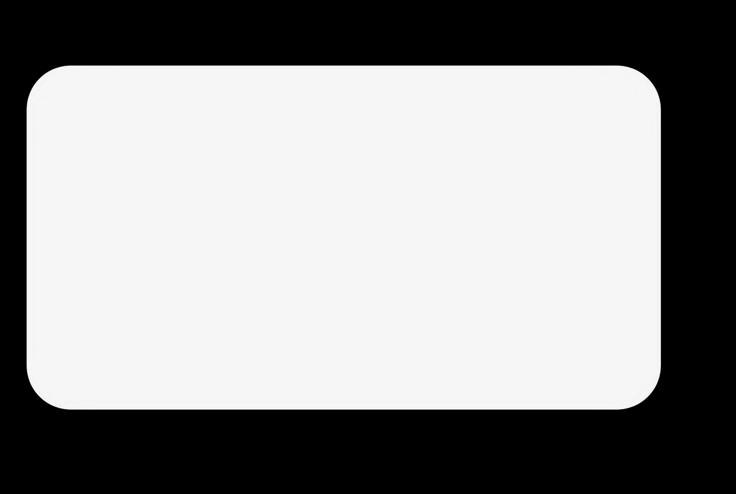

p {
color: green; text-align: right;
}
p is a selector in CSS (it points to the HTML element you want to style: <p>).
color is a property, and red is the property value
text-align is a property, and center is its value
The element selector selects HTML elements based on the element name.
Here, all <p> elements on the page will be right-aligned, with a green text color

Slide 22


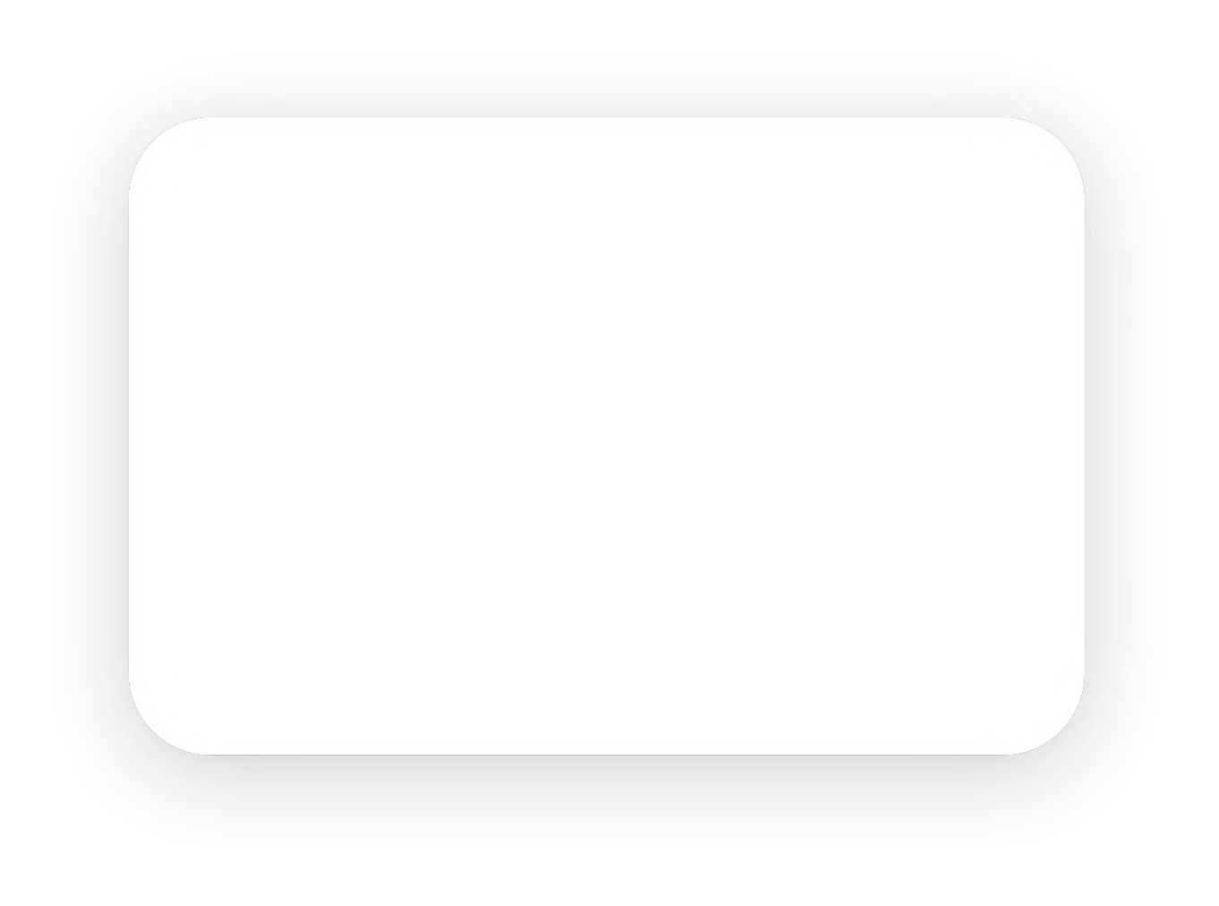
<html>
<head>
<style>
The id selector uses the id attribute of an HTML element to select a speciic element.
The id of an element is unique within a page, so the id selector is used to select one unique element!
To select an element with a speciic id, write a hash (#) character, followed by the id of the element.
#para1 {
text-align: center;
color: red;
}</style>
</head>
<body>
<p id="para1">Hello World!</p>
<p>This paragraph is not affected by the style.</p>
</body>
</html>
Hello World!
This paragraph is not affected by the style.

Slide 23


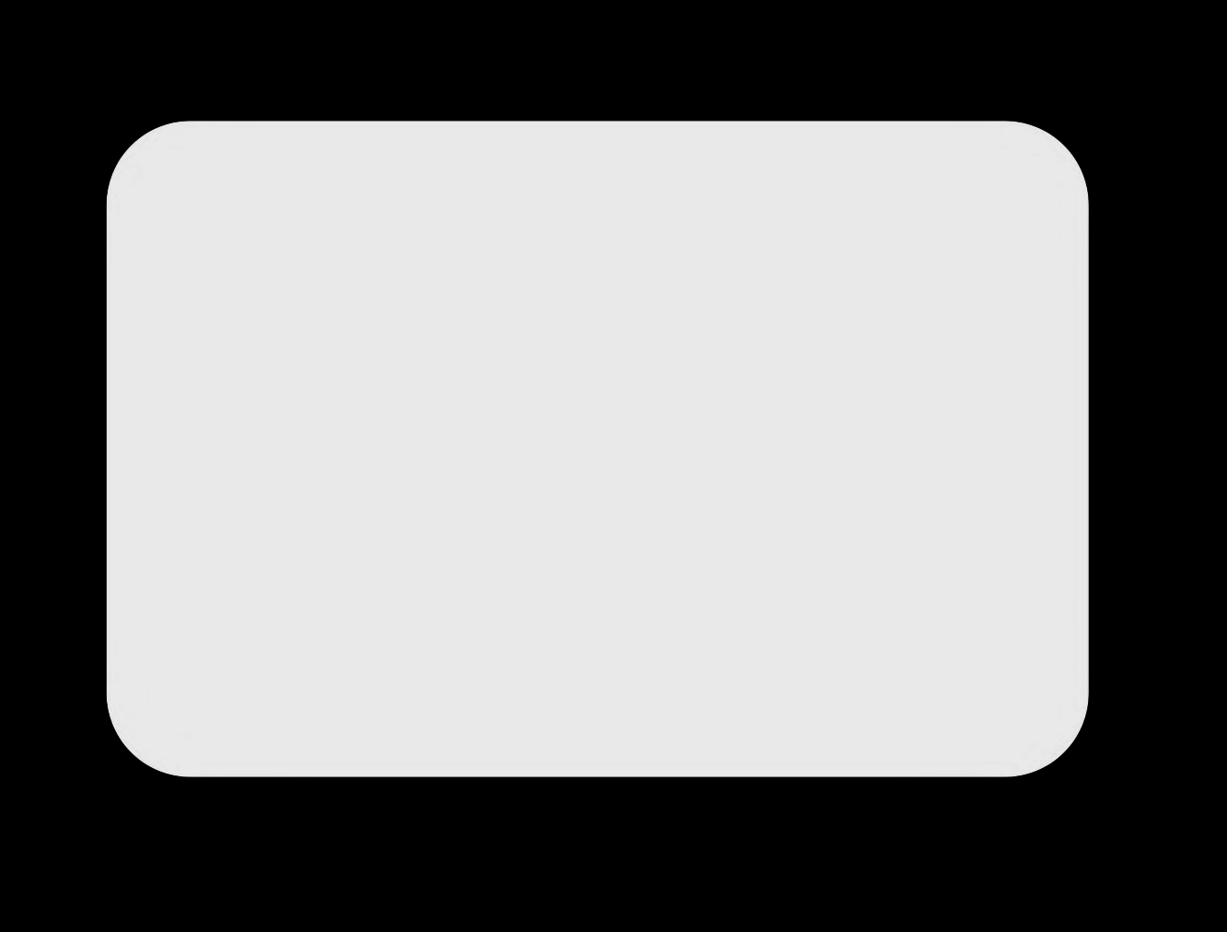
<html>
<head>
<style>
.center {
text-align: center; color: blue;
}
</style>
</head>
<body>
<h1 class="center">Red and center-aligned heading</h1>
</body>
</html>
The class selector selects HTML elements with a speciic class attribute.
To select elements with a speciic class, write a period (.) character, followed by the class name.
Blue and center-aligned heading

Slide 24




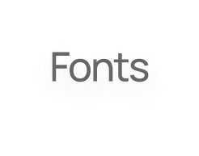
The background properties are background- color, background-image, background-
repeat, background-attachment and background- position.
The font properties are: font-style, font-variant, font-size, font-weight and font-family.
The font-family property is used to specify the font to be used to render the text.
The font-style property is used to set the font face style for the text content of an element.
The font-weight property speciies the weight or boldness of the font.
The font-variant property allows the text to be displayed in a special small-caps variation.
The background-repeat property allows you to control how a background image is repeated or tiled in the background of an element.
The background-position property is used to control the
position of the background image.
The background-attachment property determines whether the background image is ixed with regard to the viewport or scrolls along with the containing block.
shorthand notation
body { background: #f0e68c url("images/smiley.png") no-repeat ixed 250px 25px; }
shorthand notation
p {
font: italic small-caps bold 12px Georgia, serif;
}

Slide 25


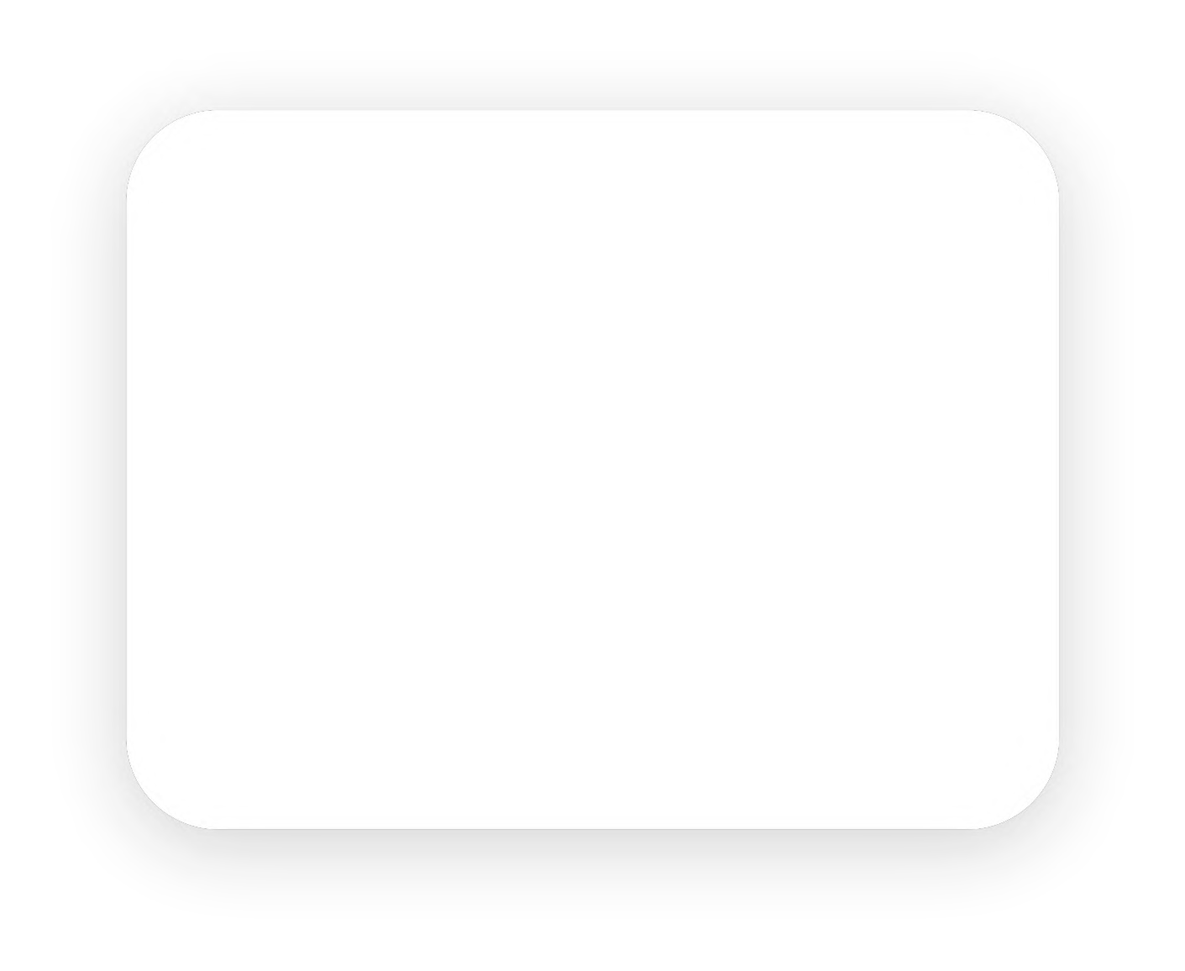

The commonly used text properties are text-align, text- decoration, text-transform, text-indent, line- height, letter-spacing, word-spacing, and more.
The text-align property is used to set the horizontal alignment of the text.
The text-decoration property is used to set or remove decorations from the text.This property typically accepts one of the following values: underline, overline, line- through, and none.
The text-transform property is used to set the cases for a text like uppercase or lowercase.
The text-indent property is used to set the indentation of the irst line of text within a block of text.
body
{
color: red;
text-align: center;
text-decoration: underline; text-transform: uppercase; text-indent: 100px;
}

Slide 26




06 Introduction to JS

Slide 27

JavaScript is a programming language that adds interactivity to your website. This happens in games, in the behavior of responses when buttons are pressed or with data entry on forms; with dynamic styling; with animation, etc.

Slide 28

<html>
<body>
<h2>What Can JavaScript Do?</h2>
<p id="demo">JavaScript can change HTML content.
</p>
<button type="button" onclick='document.getElementById("demo").innerHTM L = "Hello JavaScript!"'>Click Me!</button>
</body>
</html>

Slide 29

07 Resources

Slide 30
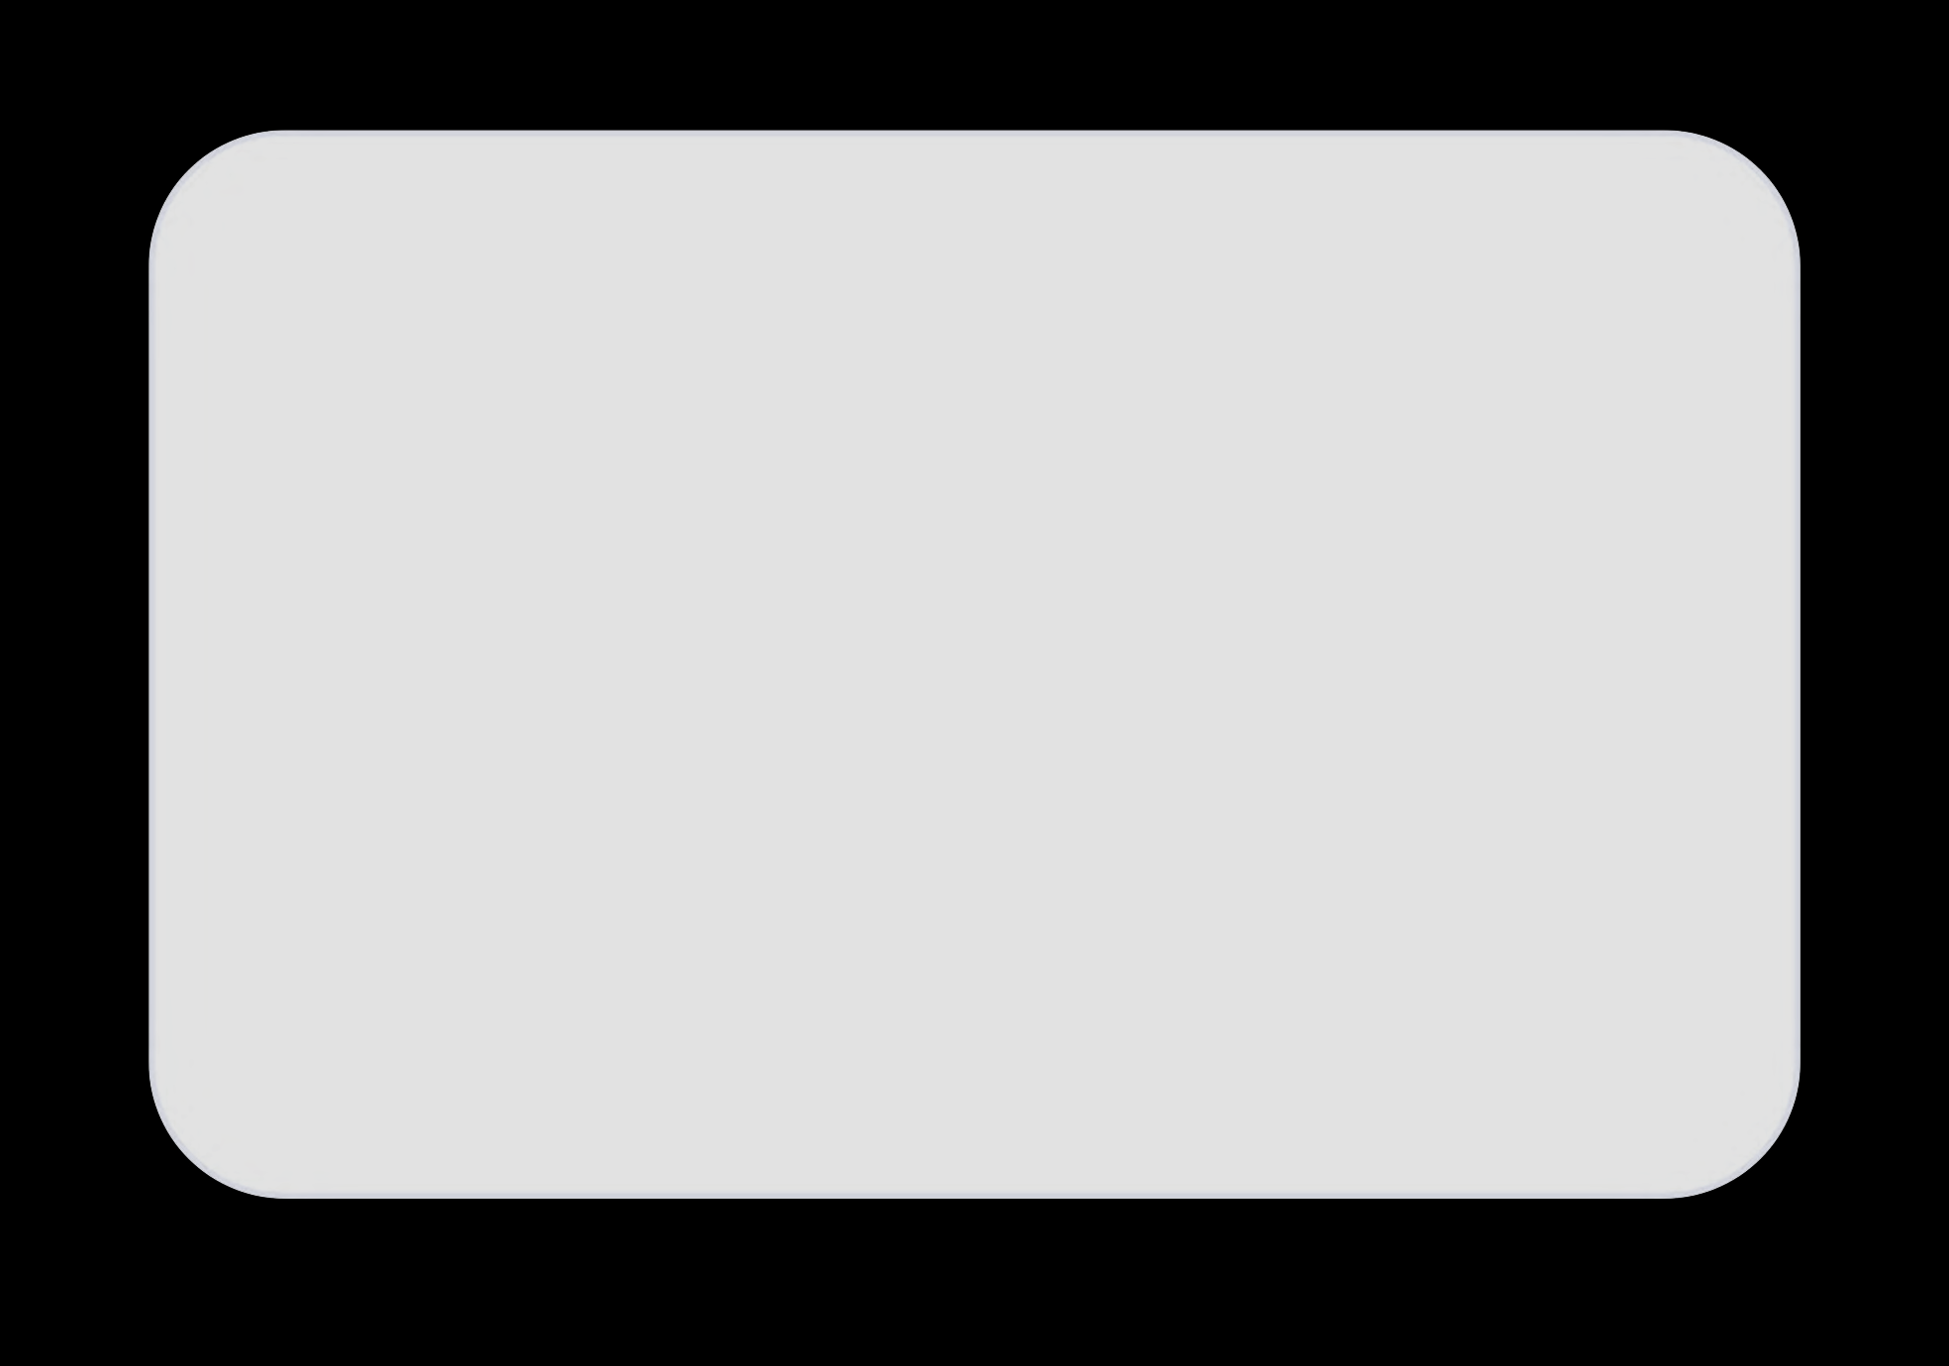

The Complete Front-End Web Development Course! (Udemy)
Programming Foundations with JavaScript, HTML, and CSS (Coursera)
The Web Developer Bootcamp 2022 (Udemy)
Front End Web Development: Get Started By Joe Eames
Front-End Web Development with React (Coursera)
freecodecamp.org 7.goalkicker.com
8. https:/ websitesetup.org/css3-cheat-sheet/

Slide 31



Slide 32
Thank You

